Slide 1
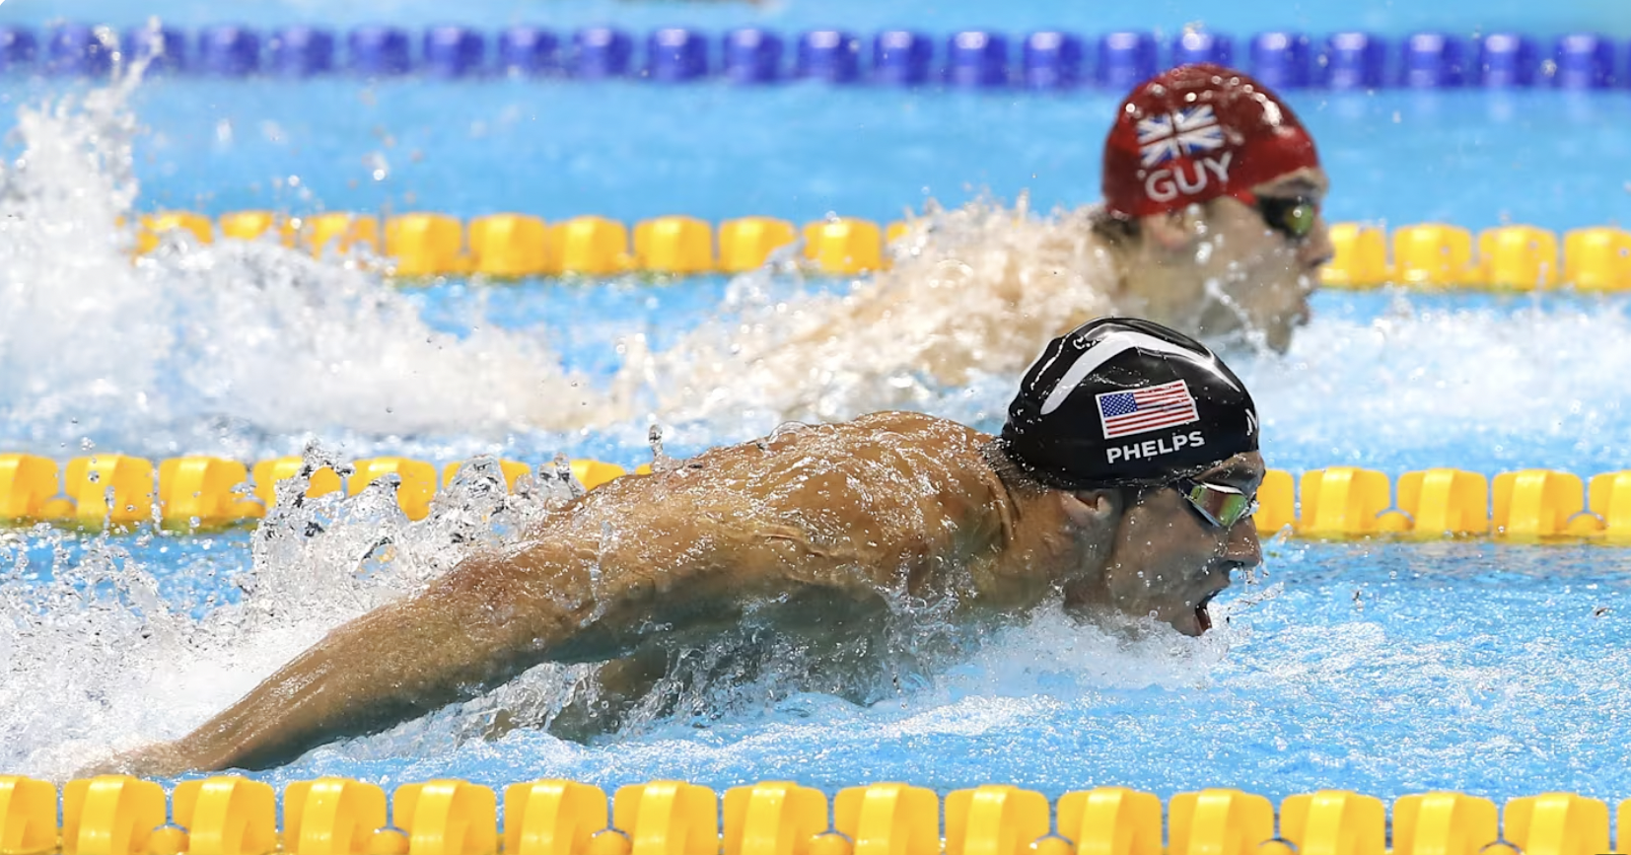
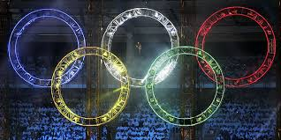
Olympic Swimming 1924 to 2020
By TKMD: Trinity Price , Keegan Fulbright, Mads Emil Boas, Devin Poteat

Slide 2
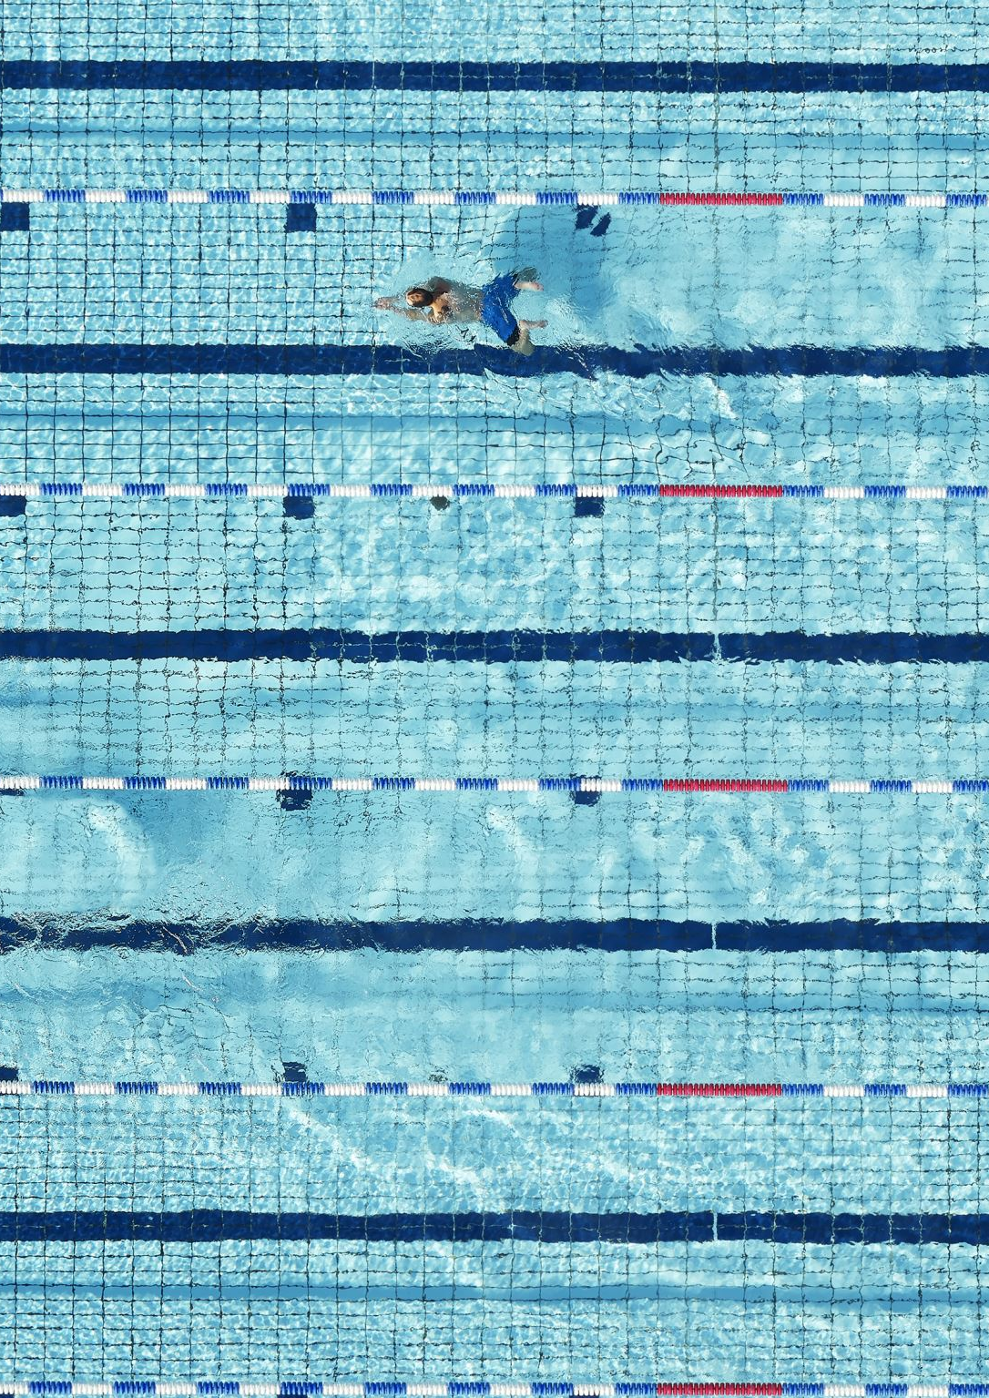
Data & Method
Data Set: Olympic Swimming 1924 to 2020
The dataset looks at Olympic swimmers 100 meter races from 1924 to 2020
https://data.scorenetwork.org/swimming/olympic_swimming.html
olympic_swimming.csv

Slide 3
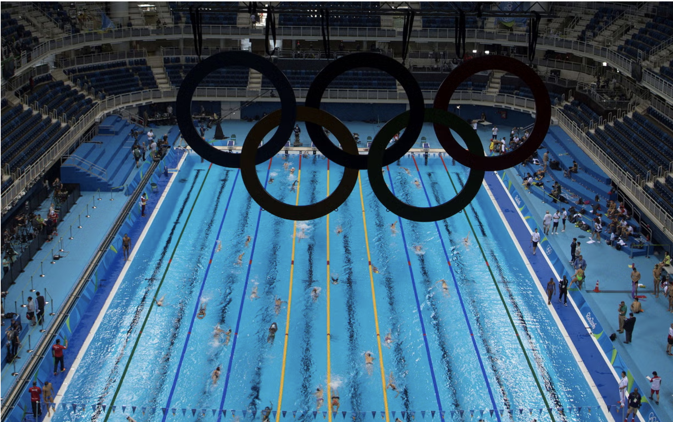
The History and Importance of Olympic Swimming from 1924 to 2020
Olympic swimming has evolved significantly from 1924 to 2020, showcasing advancements in athletic performance, training methods, and global participation. This period captures the rise of powerhouse nations, the inclusion of more events and strokes, and growing gender equity in competition. Studying this data is important because it offers insight into historical performance trends, highlights shifts in global competitiveness, and reveals the impact of technology and policy changes on results. Analyzing this dataset helps us understand how elite swimming has progressed and provides a foundation for predicting future performance patterns

Slide 4
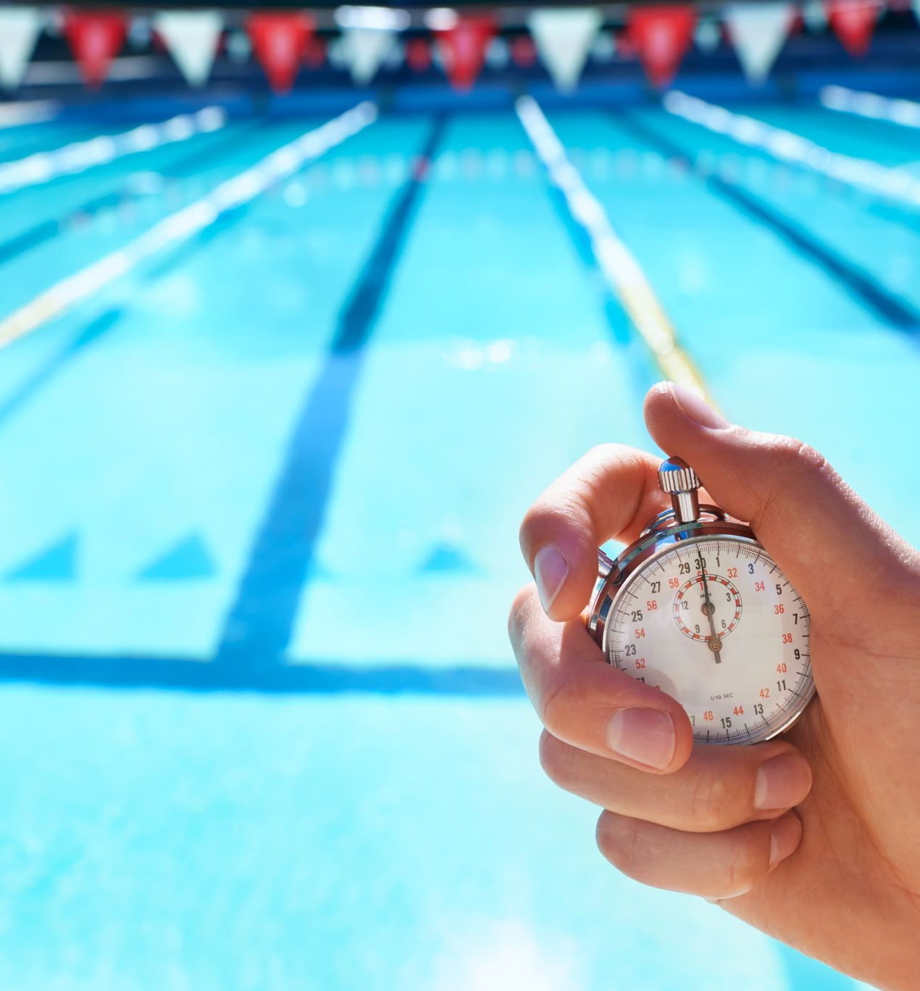
Variables Measured
Location
Year
Distance in Meters
Stroke
Gender
Team
Athlete
Results
Rank
Time Period

Slide 5
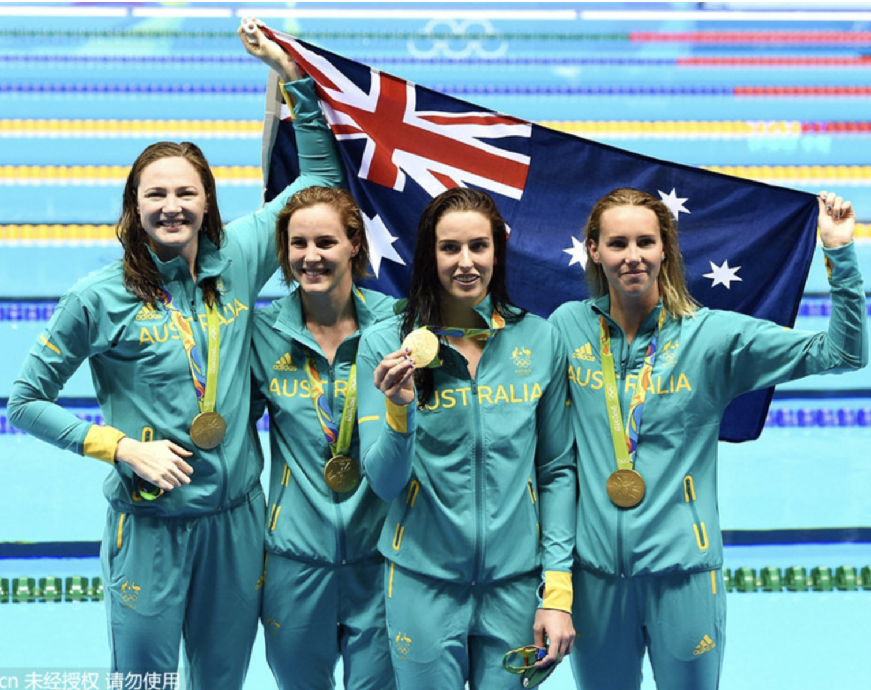
Limitations to our Data
Limited Representation of Rankings
Time Period Categorization
Incomplete Athlete Profiles
Technological and Policy Changes
There is no data provided for Women's breaststroke and no data provided for Women's backstroke until 2008

Slide 6
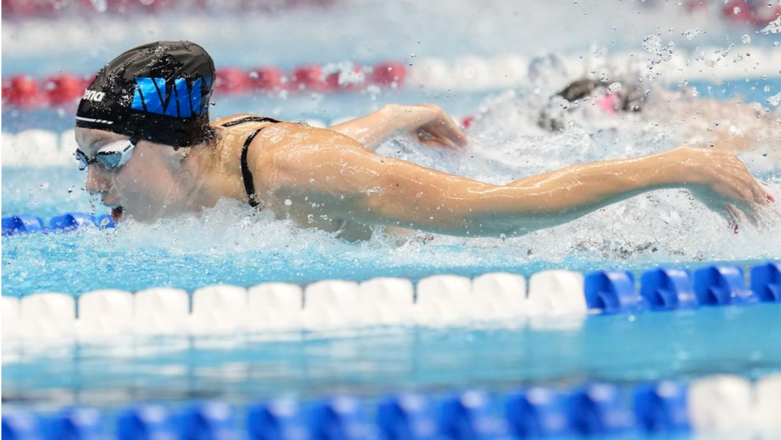
Question 1: How has the performance of Olympic swimmers evolved over across different strokes and distances?

Slide 8
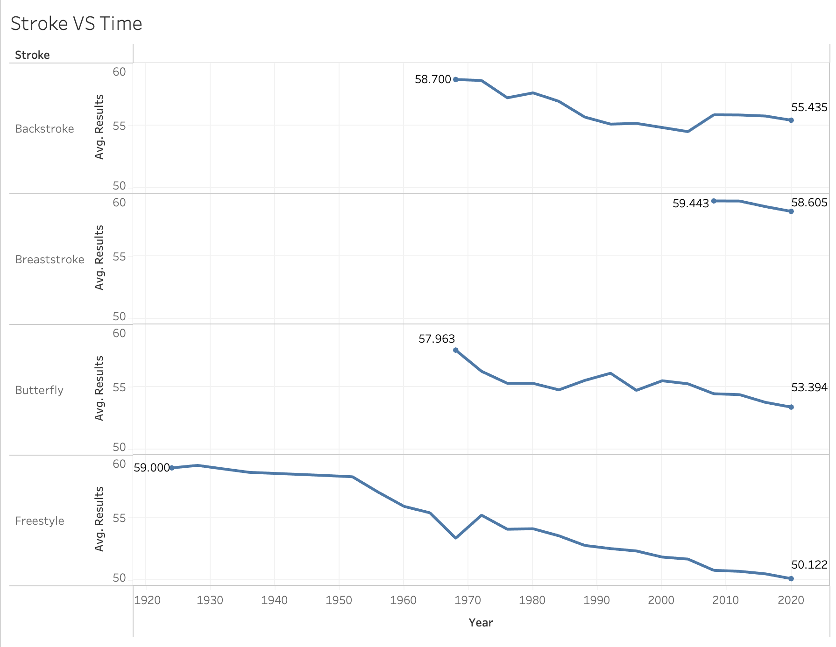

Slide 9
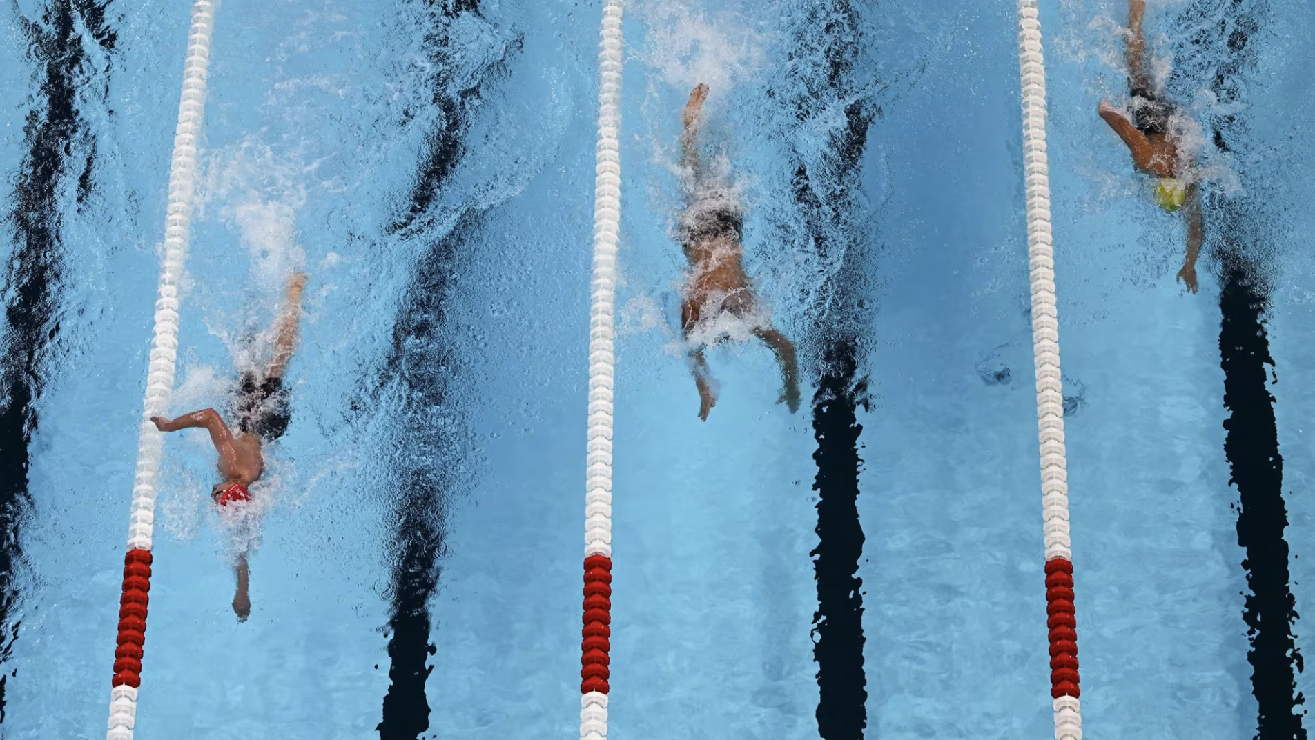
Question 2: Is there a significant difference in performance between male and female swimmers across strokes and time periods?

Slide 10
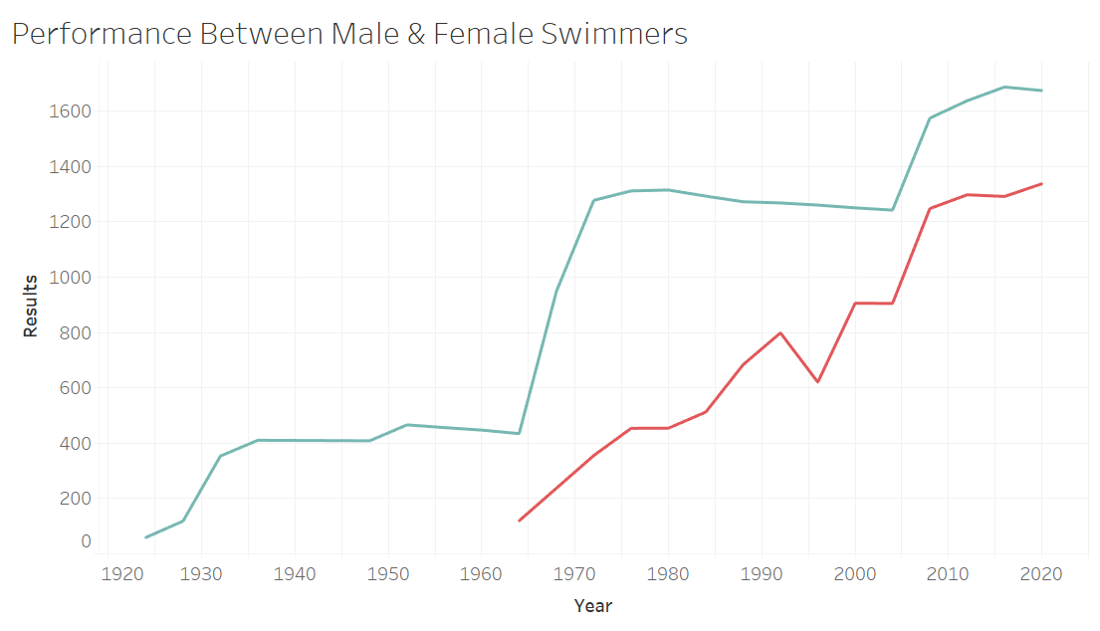
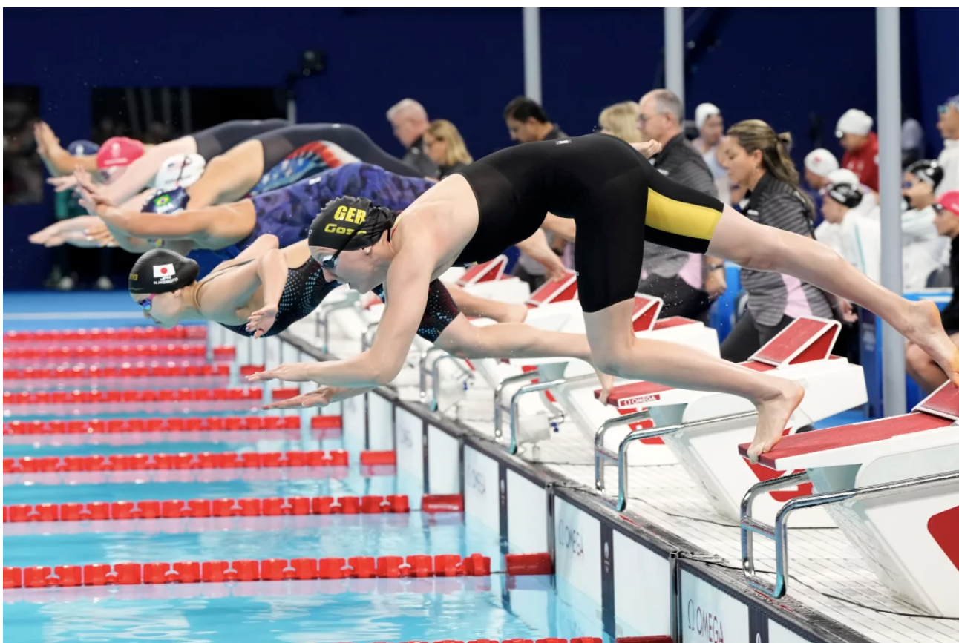
Question 2 Results
-The graph shows a significant difference in the performance between male and female athletes. This is likely due to the fact that male genetics are stronger than female genetics
- The performance gap has closed significantly from the 1960s through 2010.

Slide 11
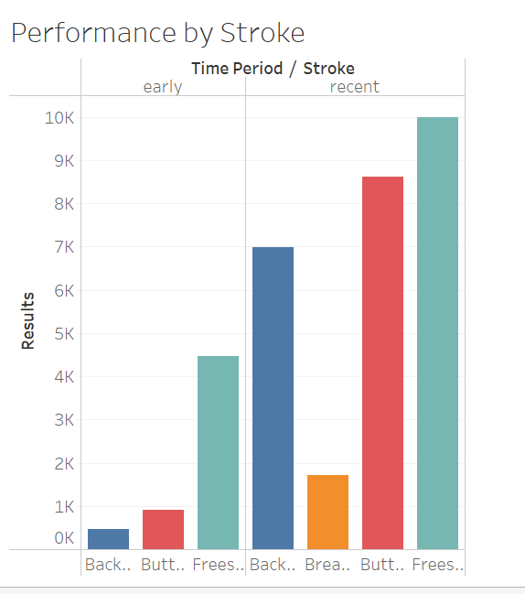

Slide 12

Question 3: Which countries have dominated Olympic swimming over time, and how has their performance changed between the early and recent time periods?

Slide 13
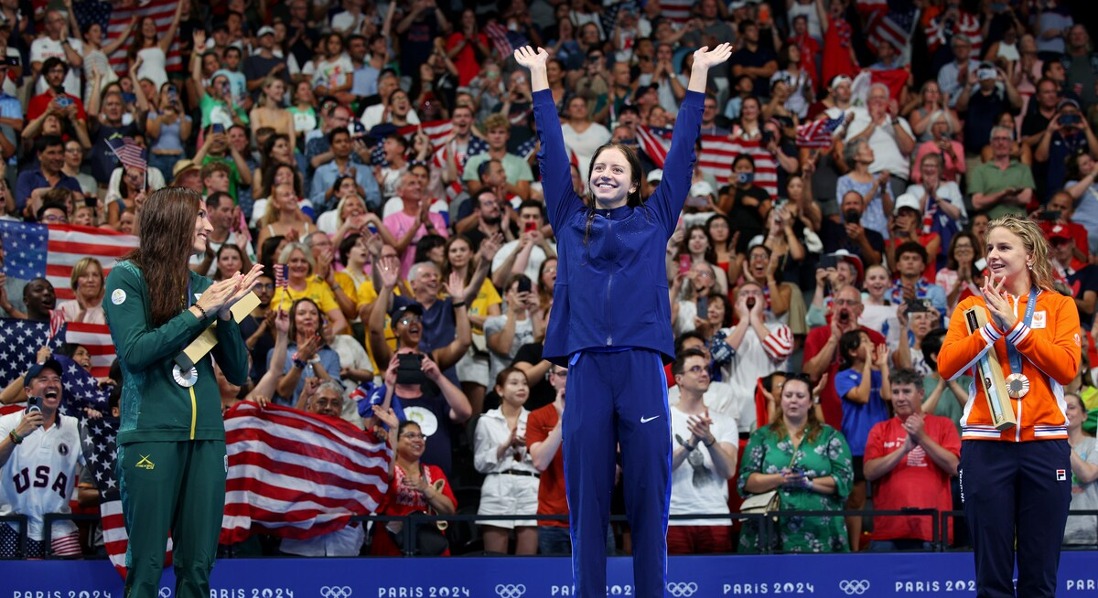
https://public.flourish.studio/visualisation/22709070/

Slide 14
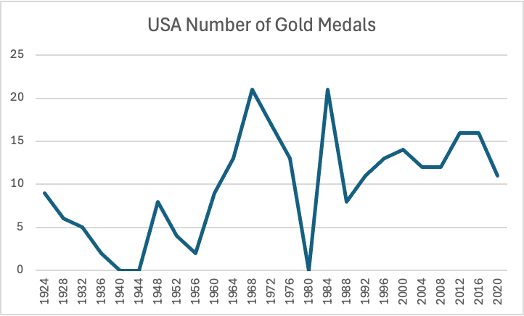

Slide 15
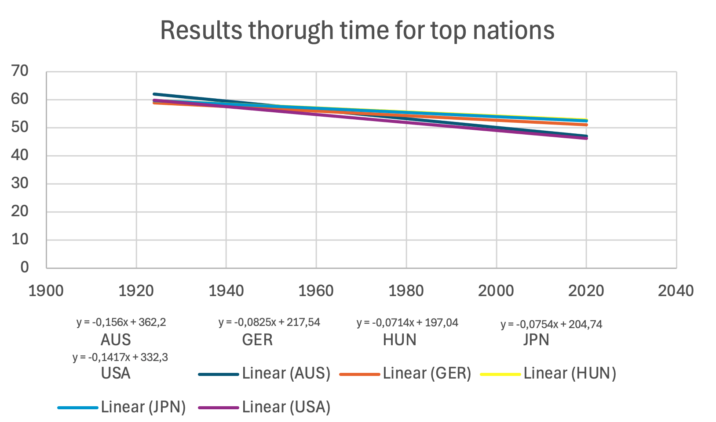

Slide 16
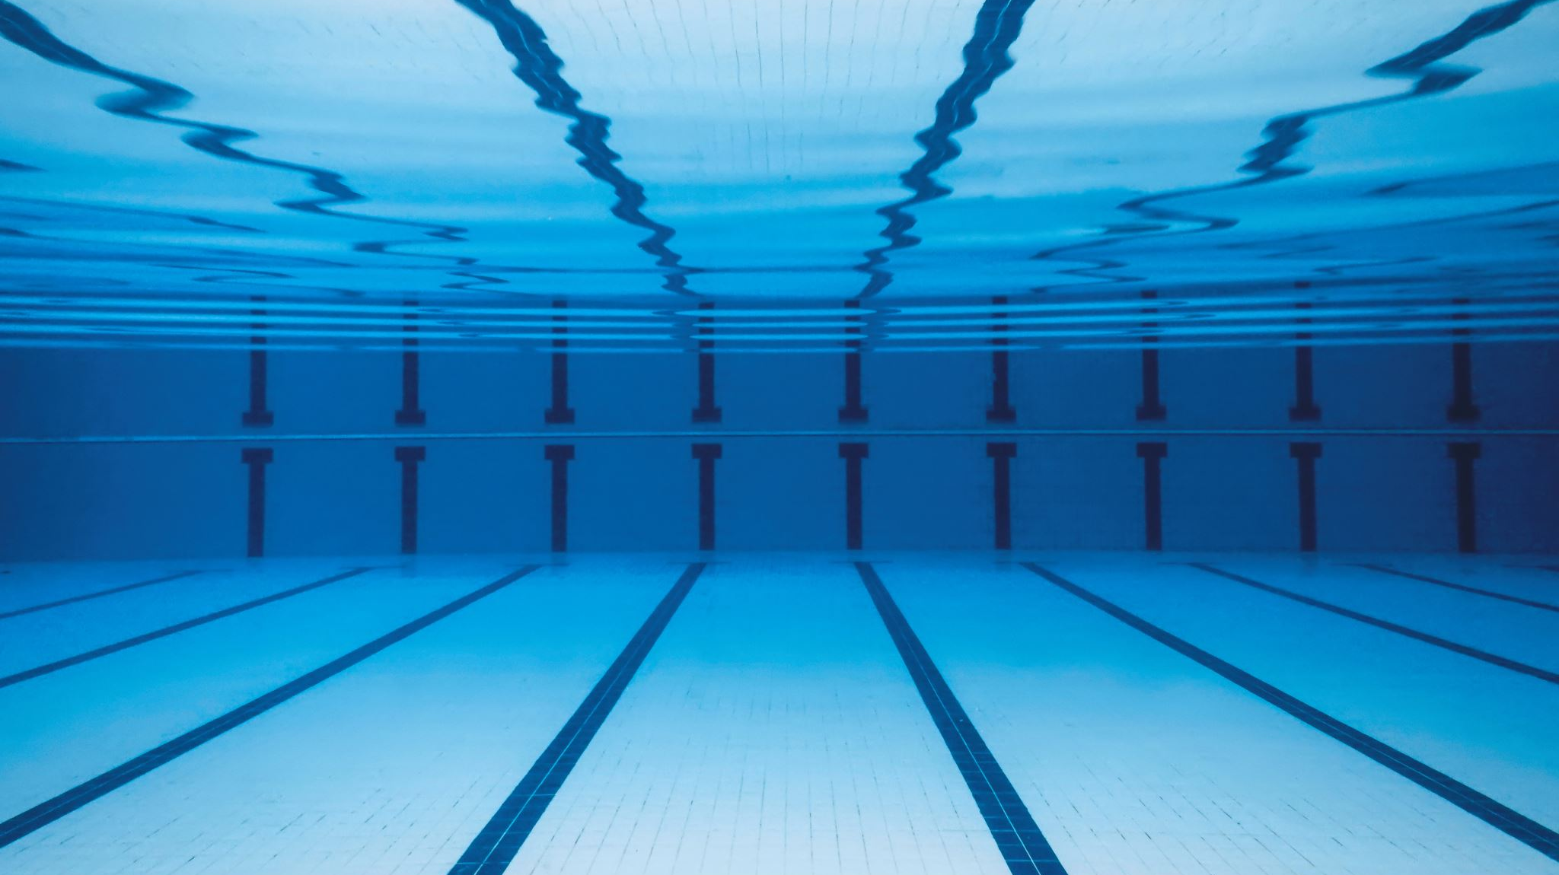
Conclusion

